Slide 1
Face and Facial feature tracking ASM, AAM, CLM
Object and Human Tracking Seminar
Noa Privman Horesh
December 2013

Slide 2
References
Cootes, Taylor, et al., “Active Shape Models: Their Training and Application.” Computer Vision and Image Understanding, V16, N1, January, pp. 38-59, 1995
T.F.Cootes, G.J. Edwards and C.J.Taylor. "Active Appearance Models", IEEE PAMI, Vol.23, No.6, pp.681-685, 2001
T.F.Cootes, G.J. Edwards and C.J.Taylor. "Active Appearance Models", in Proc. European Conference on Computer Vision 1998 Vol. 2, pp. 484-498, Springer, 1998.
Matthews, I., & Baker, S. (2004). Active appearance models revisited. International Journal of Computer Vision, 26(10), 135–164.
D. Cristinacce and T. F. Cootes. Feature Detection and Tracking with Constrained Local Models. In EMCV, pages 929–938, 2004
Based on slides of Zhaozheng Yin, Feb. 14, 2005 (ASM & AAM) and on slides of Robert Tamburo, July 6, 2000 (ASM)

Slide 3
Previous Models
“Hand Crafted” Models
Articulated Models
Active Contour Models – “Snakes”
Fourier Series Shape Models
Statistical Models of Shape
Finite Element Models

Slide 4
Motivation – Prior Models
Lack of practicality
Lack of specificity
Lack of generality
Nonspecific class deformation
Local shape constraints

Slide 5
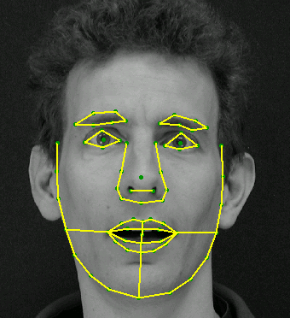
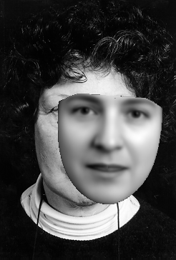

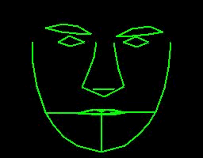
Today talk:
ASM AAM CLM

Slide 6
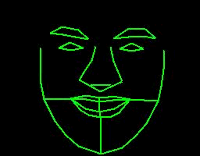
Shape
Shape is the geometric information invariant to a particular class of transformations (translation + rotation + scaling)

Slide 7
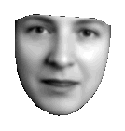
Appearance

Slide 8
Goals of Active Shape Model (ASM)
Automated
Searches images for represented structures
Classify shapes
Specific to ranges of variation
Robust (noisy, cluttered, and occluded image)
Deform to characteristics of the class represented
“Learn” specific patterns of variability from a training set
Notes:
Understanding of variability mechanisms(theoretical model of variability) are insufficient

Slide 9
Applications
Can be used to:
Locate examples of structures in new images
Classify objects found in images
Filter images to pick out interesting features
Practical problems:
Face recognition, industrial inspection and medical image analysis

Slide 10
Point Distribution Model (PDM)
Captures variability of training set by calculating mean shape and main modes of variation
Each mode changes the shape by moving landmarks along straight lines through mean positions
New shapes created by modifying mean shape with weighted sums of modes

Slide 11
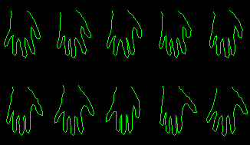
Statistical Shape Models
Given sets of training images build a statistical shape model
Each shape in the training set is represented by a set of n labeled landmark points, which must be consistent from one shape to the next.
Ex. The outline of a hand is represented by 72 labeled points
6
5
4
3
2
1

Slide 12
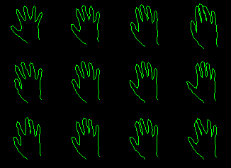
Statistical Shape Models
Each shape is represented by a 2n*1 vector
Using Principal Component Analysis (PCA) or Eigen analysis, the shape model is
where P is a 2n*t matrix whose columns are unit vectors along principle axes or basis vector
b is a t*1 vector of shape parameters or weight
Ex. Vary the first three
parameters of the shape
vector, b, one at a time

Slide 14
Aligning Two Shapes
Procrustes analysis:
Find transformation which minimizes
Resulting shapes have
approximately the same scale and orientation

Slide 15
Alignment Algorithm
Align each shape to first shape by rotation, scaling, and translation
Repeat
Calculate the mean shape
Normalize the orientation, scale, and origin of the current mean to suitable defaults
Realign every shape with the current mean
Until the process converges
Notes:
Convergence test – examine average difference between transformation required to align each shape to the recalculated mean and the identity transform

Slide 16
Application of PDMs
Applied to:
Resistors
“Heart”
Hand
“Worm” model
Faces

Slide 17
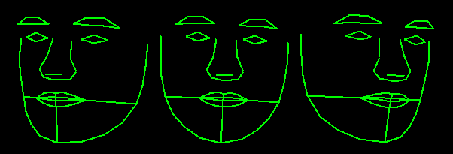
Another example…..
Shape of the facial structures with 68 points

Slide 18
Active Shape Models - ASM
Suppose we have a statistical shape model
Trained from sets of examples
How do we use it to interpret new images?
Use an “Active Shape Model”
Iterative method of matching model to image

Slide 19
PDMs to Search an Image - ASMs
Estimate initial position of model
Displace points of model to “better fit” data
Adjust model parameters
Apply global constraints to keep model “legal”

Slide 20
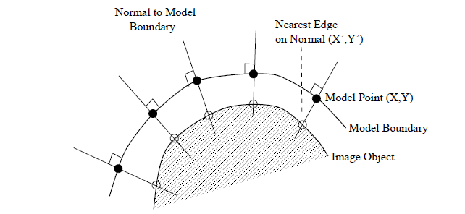
Active Shape Models (ASM)
Iterative algorithm:
Look along normals through each model point to find the best local match for the model of the image appearance at that point (e.g. strongest nearby edge)
Update the pose and shape parameters to best fit the model instance to the found points
Repeat until convergence.

Slide 21
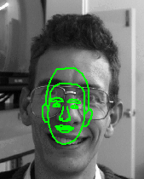
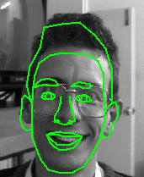
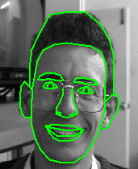
Initial pos 5th iterations convergence

Slide 22
Adjusting Model Points
Along normal to model boundary proportional to edge strength
Vector of adjustments:

Slide 23
Calculating Changes in Parameters
Initial position:
Move X as close to new position (X + dX)
Calculate dx to move X to X + dX
Update parameters to better fit image
Not usually consistent with model constraints
Residual adjustments made by deformation
where
Notes:
M(s,θ)[] is a rotation by θ and a scaling by s.
(Xc,Yc) is the position of the module center in te image frame
This equation gives a way of calculating the suggested movement to the points x in the local model coordinate frame.

Slide 24
Model Parameter Space
Transforms dx to parameter space giving allowable changes in parameters, db
Recall:
Find db such that
- yields
Update model parameters within limits

Slide 25
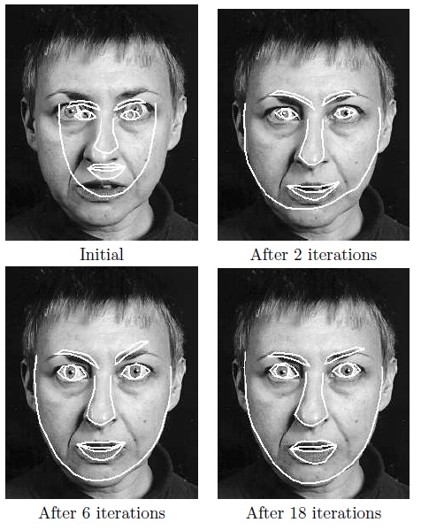
Search using Active Shape Model of a face

Slide 26
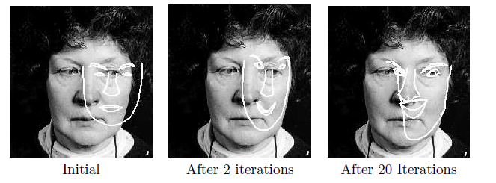
Search using Active Shape Model of a face, given a poor starting point. The ASM is a local method, and may fail to locate an acceptable result if initialized too far from the target

Slide 27
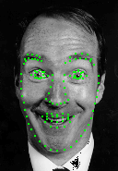
Building Appearance Models
For each example extract shape vector
Build statistical shape model,
Shape, x = (x₁,y₁, … , x_{n}, y_{n})^{T}
Notes:
where x’ is the mean shape, Ps is a set of orthogonal modes of variation and bs is a set of shape parameters.

Slide 28
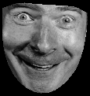
Building Appearance Models
For each example, extract texture vector
Shape, x = (x₁,y₁, … , x_{n}, y_{n})^{T}
Texture, g
Warp to
mean
shape
Notes:
To build a statistical model of the grey-level appearance we warp each example image so that its control points match the mean shape.

Slide 29
Building Texture Models
For each example, extract texture vector
Normalise vectors (as for eigenfaces)
Build eigen-model
Warp to
mean
shape
Texture, g
Notes:
We then sample the grey level information gim from the shape normalized image over the region covered by the mean shape.
To minimize the effect of global lighting variation, we normalize the example samples by applying
a scaling α, and offset β.
Let g’ be the mean of the normalized data, scaled and offset so that the sum of elements is zero and the variance of elements is unity.
where g’ is the mean normalized grey-level vector, Pg is a set of orthogonal modes of variation and bg is a set of grey-level parameters.

Slide 30
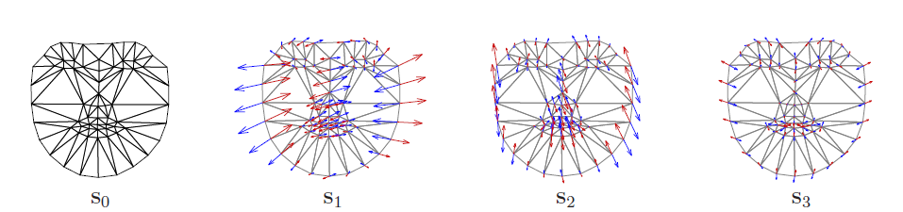
Linear shape model

Slide 31
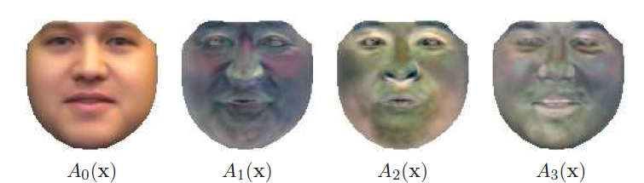
Linear appearance variation

Slide 32
Active Appearance Models
Suppose we have a statistical appearance model
Trained from sets of examples
How do we use it to interpret new images?
Use an “Active Appearance Model”
Iterative method of matching model to image

Slide 33
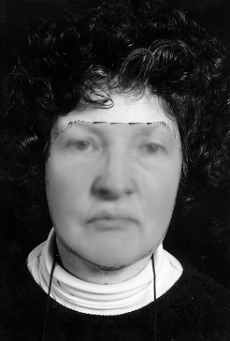
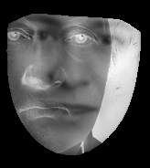
Interpreting Images
Place model in image
Measure Difference
Update Model
Iterate

Slide 34
Active Appearance Models (AAM)
AAM vs. ASM
The Active Appearance Model (AAM) is a generalization of the widely used Active Shape Model approach, but uses all the information in the image region covered by the target object, rather than just that near modeled edges.
Notes:
ASM does not incorporate all gray-level information in parameters

Slide 35
Quality of Match
Residual difference:
p : all parameters, eg
Ideally find and optimize p(p|r)
Cannot usually know p(r)

Slide 36
Quality of Match
Usually attempt to maximize
(1)
This is equivalent to maximizing
(2)
Which is equivalent to minimizing
(3)

Slide 37
Quality of Match
Assuming independent Gaussian noise:
(1)
(2)
(3)

Slide 38
Quality of Match
If we assume all parameters equally likely (within certain limits)
(1)
Thus we need to find the parameters which minimize the sum of squares of residuals, (2)

Slide 39
Learning the Relationship
For each of a training set
find best fit given landmarks, p
randomly perturb p by δp and measure
(in model frame)

Slide 40
More Analytic Approach
Taylor expansion:
Final result in the paper:
where

Slide 41
AAM Algorithm
Initial estimate I_{m}(p)
Start at coarse resolution
At each resolution
Measure residual error, r(p)
predict correction δp = -Rr
p ⇒ p - δp
repeat to convergence

Slide 42
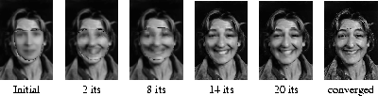
Active Appearance Models (AAM)
Example
A face model built from 400 images. The figure below shows frames from an AAM search for a new face, each starting with the mean model displaced from the true face centre.
Figure: Multi-Resolution search from displaced position

Slide 44
Problems
Automatic Model Building
Require correspondences across a set
Hard to achieve reliably
Reliable measure of quality of fit
Necessary for good matching
Essential for detection
Model initialization
Getting good initial estimate can be hard
10% percent of the image size and scale

Slide 45
AAM Summery
Parameters
An AAM contains a statistical model of the shape and grey-level appearance of the object of interest.
Goals
Matching to an image involves finding model parameters which minimize the difference between the image and a synthesized model example, projected into the image. The potentially large number of parameters makes this a difficult problem.

Slide 46
AAM Summary
Iterations
We observe that displacing each model parameter from the correct value induces a particular pattern in the residuals. In a training phase, the AAM learns a linear model of the relationship between parameter displacements and the induced residuals. During search it measures the residuals and uses this model to correct the current parameters, leading to a better fit.

Slide 47
Constrained Local Models - CLM
CLM vs ASM & AAM:
The Constrained Local Model (CLM) approach combines the power of feature detection based approaches, the flexibility of appearance based models (AAM) and the constraints of a full shape model (ASM).
The CLM learns a model of shape and texture variation from a labeled training set (similar to the AAM). However, the texture is sampled in patches around individual feature points.

Slide 48
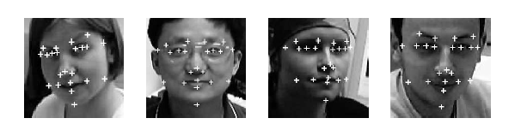
Constrained Local Appearance Models
Training examples:
A joint shape and texture model is built from a training set of 1052 manually labeled faces.
A training patch is sampled around each feature.
Notes:
A training patch is sampled around each feature
and normalised such that the pixel values have zero mean and unit variance
The texture
patches from a given training image are then concatenated to form a single grey value
vector.
The face regions from the training images are resampled to a fixed sized rectangle to allow for scale changes

Slide 49


Constrained Local Appearance Models – cont’
The set of grey scale training vectors and normalized shape co-ordinates are used to construct linear models, as follows.
Notes:
Where ¯x is the mean shape, Ps is a set of orthogonal modes of variation and bs is a
set of shape parameters. Similarly ¯g is the mean normalised grey-level vector, Pg is a set
of orthogonal modes of variation and bg is a set of grey-level parameters

Slide 50


Constrained Local Appearance Models – cont’
The shape and template texture models are combined using a further PCA to produce one joint model. The joint model has the following form:
Where
Notes:
Here b is the concatenated shape and texture parameter vector, with a suitable weighting
Ws to account for the difference between shape and texture units (see [1]). c is a set
of joint appearance parameters. Pc is the orthogonal matrix computed using PCA, which
partitions into two separate matrices Pcs and Pcg which together compute the shape and
texture parameters given a joint parameter vector c.
Given the joint model and an unseen image with a set of initial feature points, the joint model can be fitted to the image by estimating the shape, texture and joint parameters

Slide 51
Template generation
Suppose we have a set of initial feature locations, an image I and the joint model Θ learnt from the training set. Let (Xi, Yi ) be the position of feature point i. The positions can be concatenated into a vector X,
Where X is computed from the shape parameters and a similarity transformation from the shape model frame to the response image frame.

Slide 52
Shape Constrained Local Model Search algorithm
Input an initial set of feature points.
Repeat:
Fit the joint model to the current set of feature points to generate a set of templates.
Use the shape constrained search method to predict a new set of feature points.
Until Converged

Slide 53
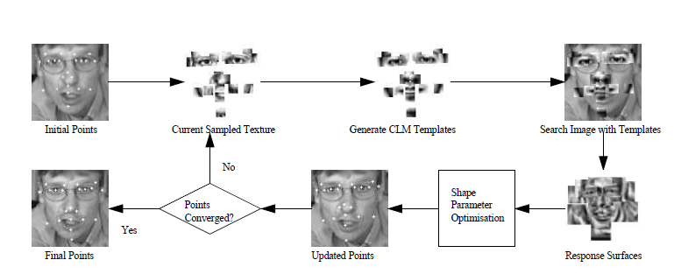
CLM search algorithm

Slide 54
Demonstration time…☺

Slide 55
Summary
There are several methods to find the feature boundaries.
Active Shape model (ASM) uses Shape constraints and searches locally for each feature point's best location.
Active Appearance Model (AAM) uses a combined statistical model of shape and texture. The AAM searches by using the texture residual between the model and the target image to predict improved model parameters in order to obtain the best possible match.
Both ASM and AAM have many variants that mostly differ in their optimization algorithm.
Constrained Local Models (CLM) learns the variation in appearance on a set of template regions surrounding individual features.
When applied to faces the CLM is more accurate and more robust than the original AAM search.
Notes:
The AAM differs from ASM in that it matches a full model of grey-level appearance to the target image whereas the ASM only locates the shape of the modeled objects, and disregards the texture, so in practice does not take full advantage of the information available.
Given current image points, the template generation proceeds by fitting the joint model of shape and appearance to regions sampled around each feature point. The current feature templates are then applied to the search image using normalized correlation. This generates a set of response surfaces.

Slide 56
References
Cootes, Taylor, et al., “Active Shape Models: Their Training and Application.” Computer Vision and Image Understanding, V16, N1, January, pp. 38-59, 1995
T.F.Cootes, G.J. Edwards and C.J.Taylor. "Active Appearance Models", IEEE PAMI, Vol.23, No.6, pp.681-685, 2001
T.F.Cootes, G.J. Edwards and C.J.Taylor. "Active Appearance Models", in Proc. European Conference on Computer Vision 1998 Vol. 2, pp. 484-498, Springer, 1998.
Matthews, I., & Baker, S. (2004). Active appearance models revisited. International Journal of Computer Vision, 26(10), 135–164.
D. Cristinacce and T. F. Cootes. Feature Detection and Tracking with Constrained Local Models. In EMCV, pages 929–938, 2004
Based on slides of Zhaozheng Yin, Feb. 14, 2005 (ASM & AAM) and on slides of Robert Tamburo, July 6, 2000 (ASM)

